Slide 1
EE 295
TechWriting-Engineering Ethics
Oct 19, 15, 2019
Room E339
Tom Wrappe
EE Lecturer

Slide 2
In Class Peer Review of the Midterm Paper
+ Final Paper
-Topic submitted
-20 sources
-Outline /Abstract
-Final Virtue Ethics session
-Growth to Professional Ethics

Slide 3
Fair Warning
-In Class writing exercise within next two weeks : On or before Oct 17, 2019
-May be at BEGINNING of class with 30 min allowed INCLUDING Instructions (which begin promptly at 4:30pm or 7:30pm)
-Attend your own section unless granted permission at least 24 hours in advance

Slide 4
Semester Major Items…..(subject to modification)
 | Mid Term | Resume | Final Paper | Final Presentation (slides )
Topic Paragraph | 9.5.19
Topic Proposed | 9.12.19 |  | 10.3.19
Topic Final | 9.19.19 |  | 10.10.19
Outline/ Abstract | 9.26.19 |  | 10.31.19
Research | 10.1.19 | 10.24.19 (Class) | 10.15.19
Draft Complete | 10.13.19 ** |  | 11.7.19 | 11.19.19
Final Submit | 10.22.19 | 11.14.19 | 11.26.19 | 12.3.19
Final Presentation | NA | NA | NA | 12.17.19 (Sect 1) 12.12.19 (Sect 2)

Slide 5
Midterm Down the Home Stretch
Step | Due | Notes
Identify topic | 2.14.19 | 1 paragraph on end product (Bring to Class)
Propose a product/ company | 2.21.19 | 600 words overview of the paper (Turnin)
Abstract/Outline | 2.26.19 | Skeleton of the paper
Research Deliverable | 3.5.19 | Supporting Elements
Draft | 3.12.19 | Complete paper, but needing edit
Final Submission | 3.22.19 | Final product

Slide 6
First 5 page Proposal A Concise version of a Business Plan
Outline | Outline/ Abstract | Draft (5 pages) | Midterm paper (5 pages) | Final Paper ? 15 pages
1. Abstract | Paragraph | ½ page max | ½ page max
2. Executive Summary | paragraph | ½ to 1 page | ½ to 1 page
3. Product Description | 2 paragraphs or so | 1-3 pages
4 Mkt Research and Analysis | 1-2 paragraphs (5 sources min) | 1-3 pages | Depends on sources
5. Finance and Economics | Short paragraph | ½ to 1 page
6. Management Team | Short paragraph | ½ page
7. Risks and Assumptions | Short paragraph | ½ page
8. Conclusions and Recommendations | Short paragraph | ¼ to ½ page
A. Sources | Not Applicable | ½ to 1 page | ½ to 1 page
The outline endures while the content grows

Slide 7
Midterm: First Draft
A first complete paper with all the elements in the outline in the right proportions
Structurally in the final form
Topic Sentences have final content, but may be “tightend up in final”
Read topic sentences of Draft and get the flow of the paper
Set up for success, but not “polished”
Abstract, Executive Summary, Conclusion are finalized last, after the Body of the paper
Body (Product Proposal and Market/product research are complete in content, but not necessarily as concise as the final)
Draft likely longer than Final
Add conciseness: Reduce wordiness/filler, remove/rewrite words to make simpler

Slide 8
Midterm: Content Checklist
Item | CHECKLIST ITEM
[a] | Abstract: Motivation Statement
[b] | Abstract: Problem Statement
[c] | Abstract: Results Statement
[d] | Abstract: Conclusions Statement
[e] | Abstract: Keywords
[f] | Executive Summary: Proposal Background
[g] | Executive Summary: Problem Statement
[h] | Executive Summary: Financial statement related to the proposal
[i] | Executive Summary: Recommended action for “boss”
[j] | Product Description: Product Description (underline all sentences that apply)
[k] | Product Description: Product Differentiators (what is “special” about the proposed product?
[l] | Conclusion: Recommendation Statement

Slide 9
Midterm: Grammar Items Checklist
It | Description | Checklist Item (to be contained in table at end of the paper)
1 | NO PERSONAL PRONOUNS | Confirm no use of “I, we, me, mine, our, ours, let’s, us, you, your, he, she
2 | No use of “Very” | Confirm no instance of “very”
3 | Avoid Passive Voice | Confirm no passive voice
4 | All paragraphs have at least three sentences | Confirm

Slide 10
Autonomous Vehicle Navigation
ABSTRACT— [a] This paper describes a system that navigates the vehicle autonomously. Autonomous vehicle navigation has gained increasing importance in modern transportation systems. [b]In non-urban domains such as deserts, the problem of successful GPS-based navigation appears to be almost solved while navigation in urban domains, particularly in the close vicinity of buildings in dense urban environments, is still a challenging problem. In such situations GPS accuracy significantly drops down due to the impaired GPS signal. [c]This system provides a communication between the vehicle and the internet using a GPRS modem. This navigation system is interfaced with OSRM open source map data through internet. To improve precision of navigation, this system uses location information from inertial sensors to complement basic GPS. The system also uses a rotatable laser range finder for obstacle sensing. This is an internet-connected system that can provide full information to a remote observer. [d]The autonomous vehicle navigation system has broad applications for self driving vehicles due to the higher navigation quality in key urban areas.
[e] KEYWORDS— GPS, GPRS, compass, navigation, localization, inertial, laser

Slide 11
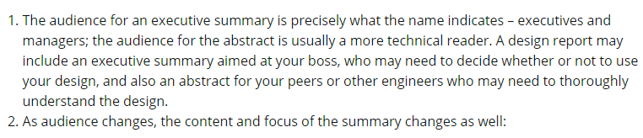
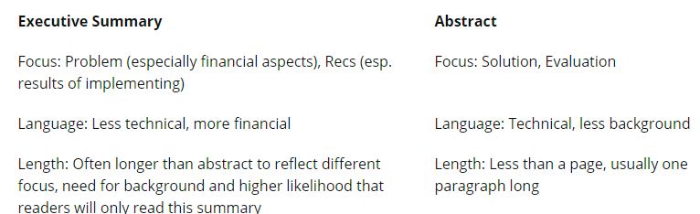
Executive Summary vs Abstract Audience Matters
[g]
[h]
[i]
[c]
[b]

Slide 12
Class Exercise 3.14
For 10.15 (after you submit draft of Midterm 10.13,
Bring a printout of your Abstract, Executive Summary and Conclusion paragraph (s) to class to exchange with team members
Inputs will help craft the final versions of these important paragraphs due 10.22
--------------------------------------------------------------------------
Abstract: Are key contents addressed? Review and mark sentences
Exec Summary: Good structure with topic sentence and concluding sentence. Financial note
Conclusion: Clear ending to paper with CALL TO ACTION

Slide 13
In Class Peer Review (1)
Exchange papers with a classmate and prepare notes for each section that will be supplied to the Author
General
Clear title and “numbered” Subsections per the outline
Sources in “ A. Reference Sources”
Proper [xx] citations in the text
Topic Sentences underlined in each paragraph with mostly first sentence in para
Title and Abstract
Descriptive title with correct capitalization. Concise: not too long
Section Title: “1.0 Abstract”
Confirm that [a] Motivation thru [e] Keywords are present
Is the Motivation statement good or maybe needs to be “punched up”
Does [a] Motivation match with [d] Conclusions?
Does [b] Problem statement match with [c] Solution Statement?
“2.0 Executive Summary”
Are [f] through [I] present
Is [g] problem statement clear?
Is [h] a clear financial statement of value?
Is [i] a clear recommendation?

Slide 14
In Class Peer Review (2)
4. “3.0 Product Description” (Do not use Proposal)
a. Is [j] a clear product description (not a vague technical collection of buzzwords)?
b. Is [k] a clear statement of what makes the product special/differentiated?
5. “8.0 Conclusions and Recommendations”
a. Is there a clear “call to action” to the boss to support this product proposal?
6. “A. Reference Sources”
a. Complete IEEE format for all sources identified in [xx}]

Slide 15
In Class Peer Review (3)
It | Description
1 | Personal Pronouns (I, we, our , us) | Verify by search
2 | No use of “very” | Verify by search
3 | Passives | Search on “is, will be, has been, etc” followed by a verb form (eg. “is developed”). Change to active
4 | Proper Paragraph Structure | Single topic sentence Do all other sentences support the topic sentence? If not, change
5 | Proper Flow | Underline topic sentences Do topic sentences of the paper flow per the outline (Sect 1-8)?

Slide 16
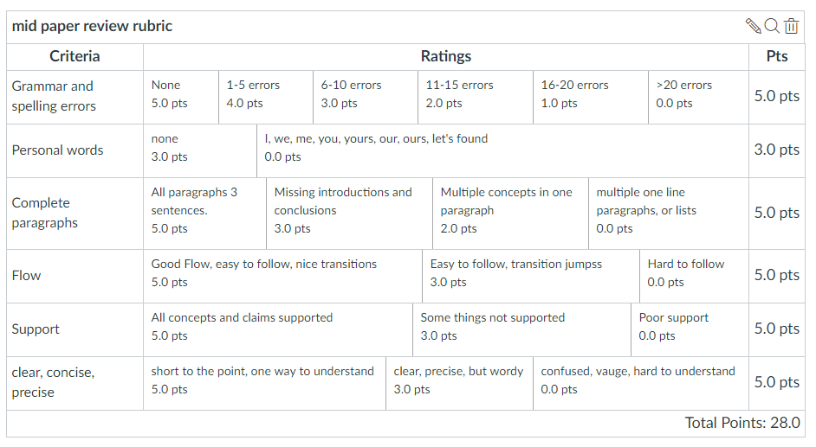
Midterm Paper Rubric

Slide 17
Final Paper: Research

Slide 18
Expanding the Product Proposal for a Final Paper
Outline | Outline/ Abstract | Draft (5 pages) | Midterm paper (5 pages) | Final Paper ? 15 pages
1. Abstract | Paragraph | ½ page max | ½ page max | 1. Abstract
2. Executive Summary | paragraph | ½ to 1 page | ½ to 1 page | 2.Executive Summary
3. Product Description | 2 paragraphs or so | 1-3 pages |  | 3.0 Product Description (ex.) 3.1 System Description (ex) 3.2 Key technologies 3.3 Functional Description (ex.)
4 Mkt Research and Analysis | 1-2 paragraphs (5 sources min) | 1-3 pages | Depends on sources | 4.0 Mkt Rsch 4.1 Market 4.2 Competitors 4.3 Differentiators
5. Finance and Economics | Short paragraph | ½ to 1 page
6. Management Team | Short paragraph | ½ page
7. Risks and Assumptions | Short paragraph | ½ page
8. Conclusions and Recommendations | Short paragraph | ¼ to ½ page |  | 8. Concl/ Rec’s 8.1 Useful features 8.2 Recommended action
A. Sources | Not Applicable | ½ to 1 page | ½ to 1 page

Slide 19
Framework for Research Option #2
Area of Research
The “container” is the Analysis Process you choose:
-Compare multiple technologies by measuring their performance in a consistent “test” process (Comparative Analysis)
-Measure a single technology’s ability to perform a previously unachievable “test” (Feasibility Study)
Specific Topic
(Describe Specific Research
Research is a fluid.
It has the form of the container you choose.
Criteria for Analysis
ANALYSIS
Results and Implications
Conclusions &Recommendations

Slide 20
Final Paper: Research Sources Summary due Oct 15
Submit 20 references related to your topic. Write a paragraph about each related to the info that applies to your topic.
Remember to use IEEE format for citations to identify each source
-Try to get at least 4 different classes of sources: Books, periodicals, journals, online sources, Manufacturer product info, ….
-Consider using figures, drawings, etc from the sources if that is useful (remember, they get cited differently than other sources)
-Use a consistent, concise approach:
a. Source in IEEE format based on author’s center
b. Fully constructed sentences (not bullets and not phrases) identifying the contribution of the document to your paper based on your study of the item

Slide 21
Professional Ethics
Foundation in Virtue Ethics
-Objectivity
-Honesty
-Caring

Slide 22
Important Notes about the Code of Ethics
It is not a legally binding document.
It is not something that we want (or need) engineers to memorize.
It is something we want engineers to understand and be able to live by as engineers.
However, in the beginning knowing the code is a guide to understanding how to apply it.

Slide 23
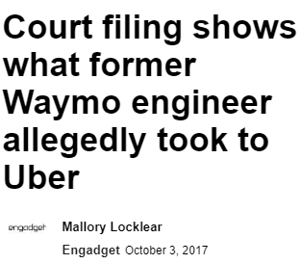
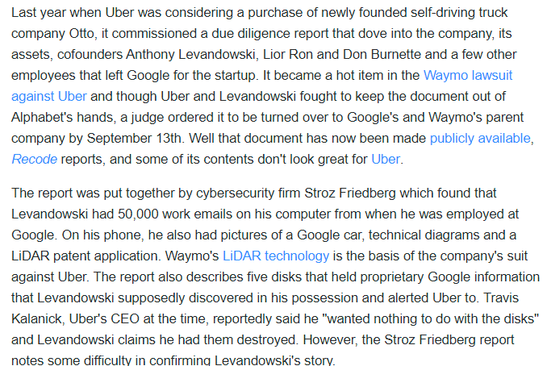
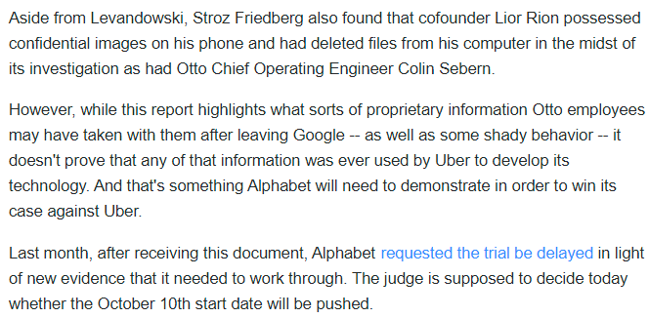

Slide 24
Uber –Otto Case https://finance.yahoo.com/news/court-filing-shows-former-waymo-161100457.html
In 2016, Uber was considering buying a self-driving truck business called Otto
Otto founders were Anthony Levandowski, Lior Ron and Don Burnette, formerly Waymo/Google employees
Uber commissioned a due diligence report related to Otto before buying
In August 2016, Uber closed the deal and bought Otto
Waymo separately sued Uber for IP infringement related to LiDAR and requested access to the due diligence report
Levandowski had 50,000 work emails from his Google employment as well as Google car photos, technical diagrams and a LiDAR patent application
Levandowski also discovered 5 disks in his possession that had Google proprietary info during his relationship with Uber and notified the Uber CEO that “he (Levandowski) wanted them destroyed”
Lior Ron had Google images on his phone and computer that he destroyed during the investigation
In order to win their case against Uber, Waymo/Google must prove that the inputs from the Otto founders were used to develop the Uber LiDAR product(s)
Given that the Uber Due Diligence report was received BEFORE Uber bought Otto, did Uber management display Virtue Ethics in completing the acquisition? Support your answer. If not, what should Uber have done before going forward to acquire Otto?
(note: Do NOT provide ethical analysis of Levandowski, Ron and Burnette)

Slide 25
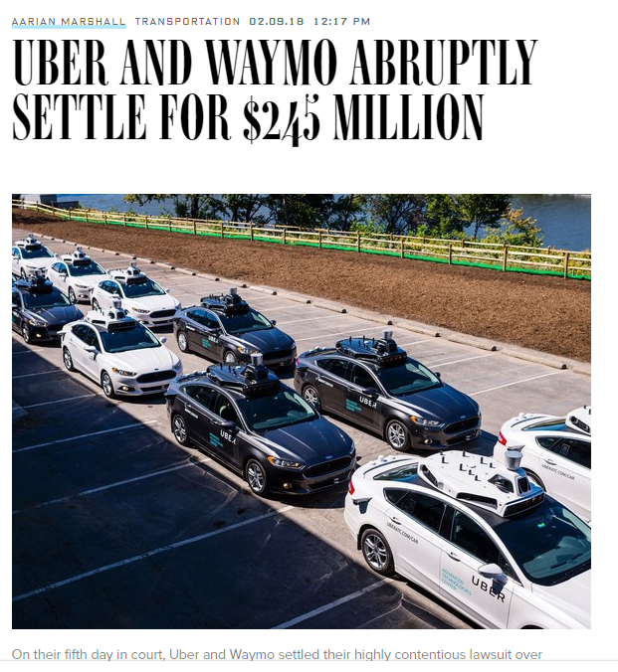
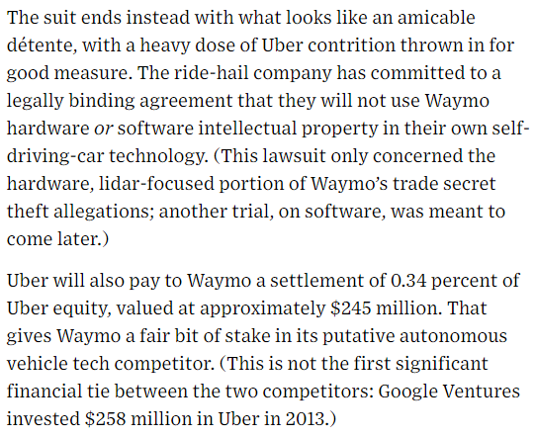
Feb 18, 2018: Settlement!

Slide 26
Ethics Takes Practice Knowledge vs. Behavior
Unlike robots, no one can just program you to be an ethical engineer that follows the codes.
It is possible to know the codes of ethics for engineering (or being a student), yet fail to follow them.
Ethical behavior is about practice and virtue. It is about going beyond the codes, and practicing behavior that leads to an ethical life.

Slide 27
Law vs. Morality: Don’t Confuse the Two
Legal & Moral | Legal & Immoral
Illegal & Moral | Illegal & Immoral

Slide 28
Examples of the Categories
Legal & Moral | Designing a system to be safe for appropriate users
Legal & Immoral | Owning a slave pre-civil war in the US
Illegal & Moral | Parking in a no parking zone, to come to the aid of an injured person
Illegal & Immoral | Killing an innocent person

Slide 29
In Class Team Presentation: Team and Individual Ethics
You are running a critical project. Your Engineers work 12 hour days (and, as "exempt" employees, do not receive overtime pay).
You totally abuse the Petty Cash system to furnish delicious German sandwiches and a can of beer in the evenings, some cash for baby sitters, and other small emoluments to help them.
You are legally stealing from the company to cover the costs. Are you a criminal or are you virtuous (objective, honest, and caring, while practicing phronesis) ?
Form the team and designate the spokesperson
Follow the process of Ethical Analysis
Apply tenets of Virtue Ethics
Present your results to the class concisely and well supported

Slide 30
Backup Slides

Slide 31
Part 2: Practicing Ethics as an Engineering Student

Slide 32
SJSU Students Have a Code of Ethics
Senate Policy S07-2 (http://www.sjsu.edu/senate/S07-2.htm)
The San José State University Academic Integrity Policy requires that each student:
1. Know the rules that preserve academic integrity and abide by them at all times. This includes learning and abiding by rules associated with specific classes, exams and course assignments.
2. Know the consequences of violating the Academic Integrity Policy.
3. Know the appeal rights, and the procedures to be followed in the event of an appeal.
4. Foster academic integrity among peers.

Slide 33
S07-2 Preamble
The University emphasizes responsible citizenship and an awareness of ethical choices inherent in human development.
Academic honesty and fairness foster ethical standards for all those who depend upon the integrity of the university, its courses, and its degrees.
University degrees are compromised and the public is defrauded if faculty members or students knowingly or unwittingly allow dishonest acts to be rewarded academically.

Slide 34
Plagiarism & Cheating
Many components go into being a good engineering student.
One of the most important, as reflected by the codes of ethics for engineers, is to be competent in your field of engineering.
To be competent, it is necessary that one actually knows what they claim to know.
Proving to others that you know what you are supposed to know requires certification through a degree.

Slide 35
What students Say
70% of American high school seniors admit to cheating on at least one test
95% of the students who said they cheated were never caught.
An average of 75% of college students report cheating sometime during their college career
Notes:
Cheating in Online Student Assessment: Beyond Plagiarism, Neil C. Rowe 2004

Slide 36
Academic Dishonesty
Cheating
At SJSU, cheating is the act of obtaining or attempting to obtain credit for academic work through the use of any dishonest, deceptive, or fraudulent means.
SJSU defines 5 basic types of cheating

Slide 37
Cheating is Wrong?
Cheating also undermines the work of fellow students who are honest.
When you cheat, all the other students who didn’t cheat are penalized. They end up getting lower grades. As a consequence of lower grades they lose out on scholarships and recommendations.

Slide 38
Cheating vs. Teamwork
Working on a team for an assigned project is not cheating.
However, failing to do your assigned task on an a team project is a form of cheating. It is called free-riding, which is benefiting from the work of others without doing any work of your own.
Teamwork is important in engineering, but free-riding is wrong, since if everyone did it nothing would get done.

Slide 39
Copying
One obvious type of cheating that we all recognize is copying someone’s work on a homework assignment, exam, or paper.
Submitting someone’s work as your own is a kind of cheating.

Slide 40
Multiple Submissions
Submitting your own work from one class to another class or submitting one piece of work to two distinct classes is a kind of cheating.
A paper for one class is not a paper for another class without advance permission.

Slide 41
Unauthorized Sources
Using sources that one is not allowed to use as deemed by the instructor or the university as a whole is a kind of cheating, such as solution manuals.
Also a text message from your friend with the answer to a question on the exam is a form of cheating.

Slide 42
Altering Grades
Altering your grade in any way is a form of cheating.
If you are given a C on your homework, paper, or exam and then you change your grade to a B+, you have cheated.

Slide 43
Surrogate
Surrogate cheating occurs when someone else either does your homework, takes an exam for you, or writes your paper.
Doing someone’s work for them is a kind of cheating.

Slide 44
Why is Cheating Wrong?
Cheating undermines the credibility of the university and the degrees it awards.
If too many people cheat at SJSU, then the degrees awarded by SJSU won’t certify that its students are competent. So, by cheating you not only hurt yourself, you also hurt others.

Slide 45
Ethics – Courage & Integrity
As we will be seeing more and more being ethical requires:
Courage to do the right thing the situation calls for.
&
The integrity to withstand the pressures that push you in the wrong direction.

Slide 46
Resume Presentation

Slide 47
Start the Resume Research
-Posted on Canvas
-Final Due Nov 1, 2018
-BRING AT LEAST ONE JOB POSTING TO CLASS TU, Oct 16 and Thu, Oct 18
-Find three (3) job postings. Analyze them, and determine what will influence the company to select you for consideration.
Write an analysis paragraph for each indicating how you think they will make the decision, what you have to offer, what you hope to get, and what the company will offer, and what they hope to get.
Indicate what you will place in the resume to influence the decision maker. Look beyond just the technical.
Write a targeted resume for each company.
Submit analysis and resumes on Canvas. The analysis will be plagiarism checked. Please put analysis and resumes in separate files. The resumes will be checked, but not scored.

Slide 48
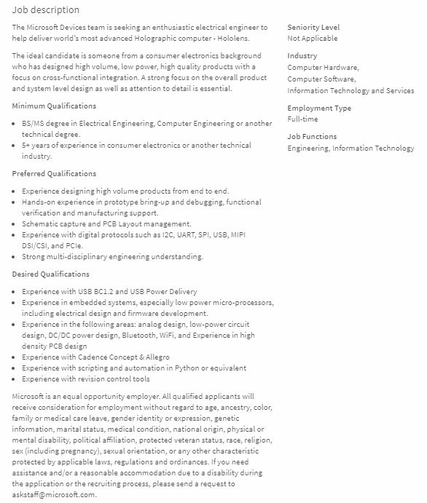


Slide 49
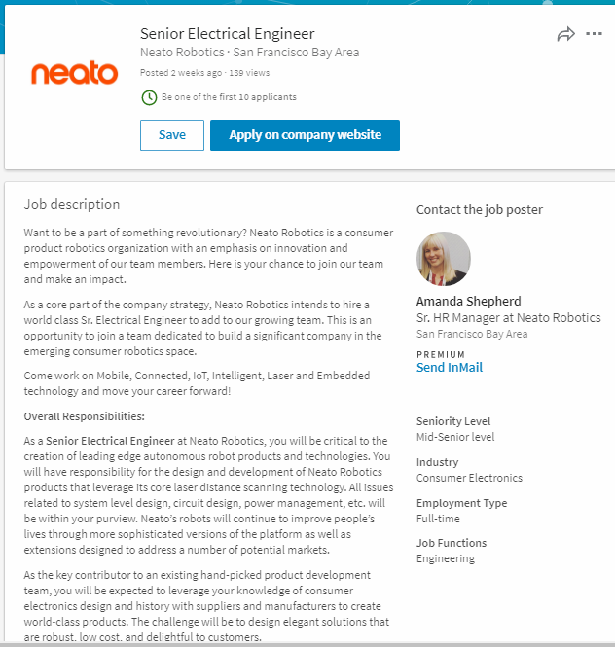

Slide 50
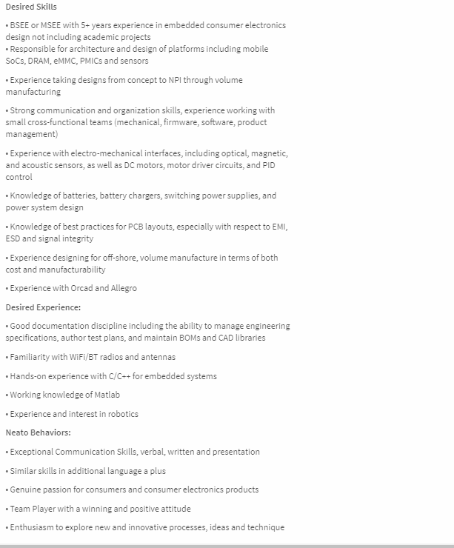

Slide 51
Key Elements of Job Descriptions
Job Overview
Area
Responsibilities
Qualifications
Minimum
Preferred
Experience
Special Opportunities/ “Wild Cards”

Slide 52
Fair Warning
In Class Writing Exercise starting at beginning of class coming within next four weeks
Allowed 20 minutes to complete (hard stop at 4:50 pm)
Topic will be per recent class lectures and discussions
Up to 10 points with 0 for “no show”
No makeups per syllabus

Slide 53
Virtue Ethics Final Wrapup
Objectivity, Honesty and Care are basic virtues
Overall virtue is weighted average of the basic variables
Application of the weighting factors is driven by phronesis of the investigator

Slide 55
Uber –Otto Case https://finance.yahoo.com/news/court-filing-shows-former-waymo-161100457.html
In 2016, Uber was considering buying a self-driving truck business called Otto
Otto founders were Anthony Levandowski, Lior Ron and Don Burnette, formerly Waymo/Google employees
Uber commissioned a due diligence report related to Otto before buying
In August 2016, Uber closed the deal and bought Otto
Waymo separately sued Uber for IP infringement related to LiDAR and requested access to the due diligence report
Levandowski had 50,000 work emails from his Google employment as well as Google car photos, technical diagrams and a LiDAR patent application
Levandowski also discovered 5 disks in his possession that had Google proprietary info during his relationship with Uber and notified the Uber CEO that “he (Levandowski) wanted them destroyed”
Lior Ron had Google images on his phone and computer that he destroyed during the investigation
In order to win their case against Uber, Waymo/Google must prove that the inputs from the Otto founders were used to develop the Uber LiDAR product(s)
Given that the Uber Due Diligence report was received BEFORE Uber bought Otto, did Uber management display Virtue Ethics in completing the acquisition? Support your answer. If not, what should Uber have done before going forward to acquire Otto? (1/2 page concise statements)
(note: Do NOT provide ethical analysis of Levandowski, Ron and Burnette)

Slide 56
Feb 18, 2018: Settlement!

Slide 57
Group Discussion / Presentations
Form Groups
Take turns discussing your Finals Topic and dialogue on the chosen option:
Enhanced Product
Research Area
Masters Project
Choose one of your group to present their individual topic with the following minimum info:
 | Enhanced Product (#1) | Research Area /Masters Project (#2)
Area of Interest | Industry | Area of Research
Topic Subject | Deliverable Product | Research Topic
Key Differentiators | Competitive Advantages | Key Criteria for Analysis

